Slide 1
Supporting figures

Slide 2
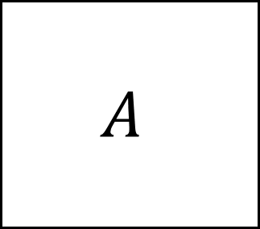
Association matrix factorization
Species
d
$$A$$
ρ
α
Species
≈
Species
Species
X
d
Association
Response
embeddings
Effect
embeddings

Slide 3
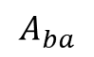
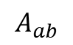
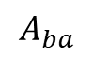
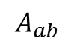
Association classification
$$A_{ba}$$
$$A_{ab}$$
a
b
$$A_{ba}$$
Symmetric associations
$$A_{ab}$$
Neutral association
Amensalism
Commensalism
Mutualism
Competition
Trophic/Parasitic

Slide 4

Plate model
ρ
Y
e
X
d
Z
α
$$C$$
M
N

Slide 5
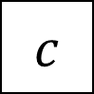
Plate model
ρ
y
e
X
d
z
α
$$c$$
M
N

Slide 6
Architecture
Abiotic feature extraction
Biotic context
Habitat Suitability Model
Abundance Model

Slide 7
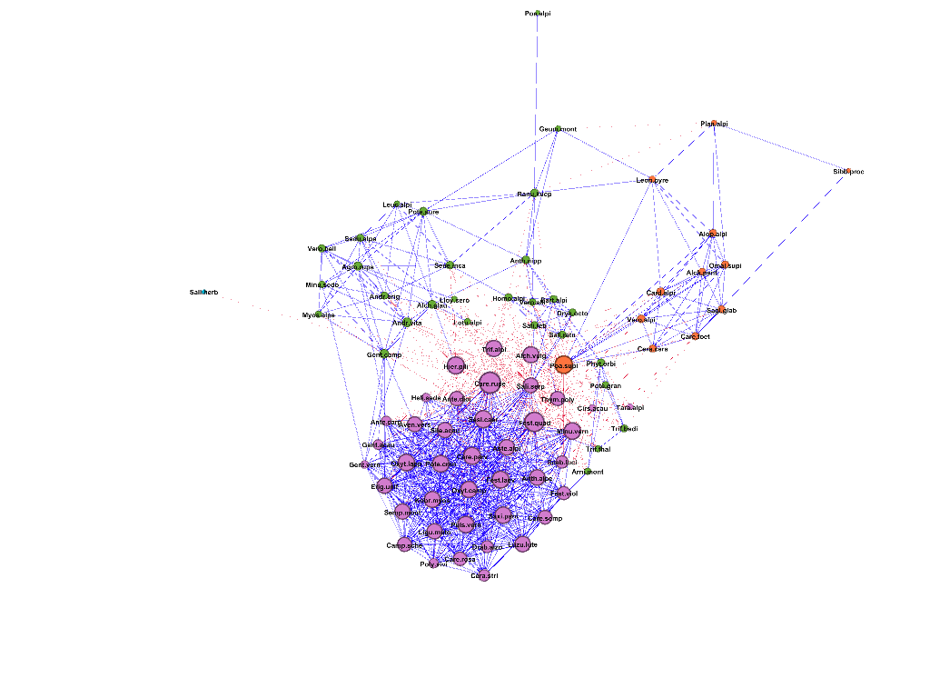
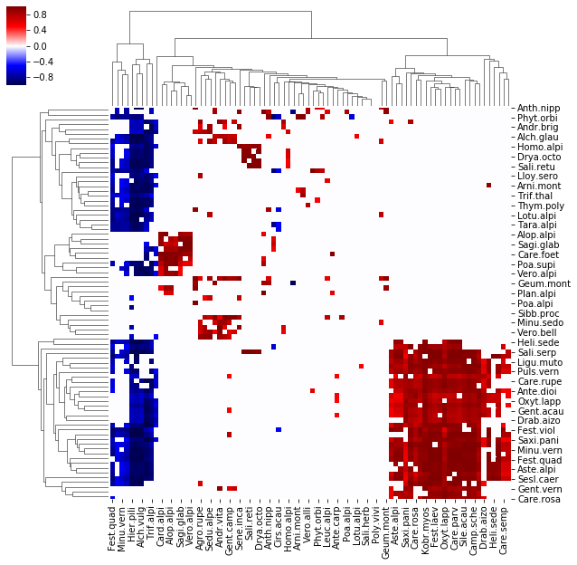

Slide 8
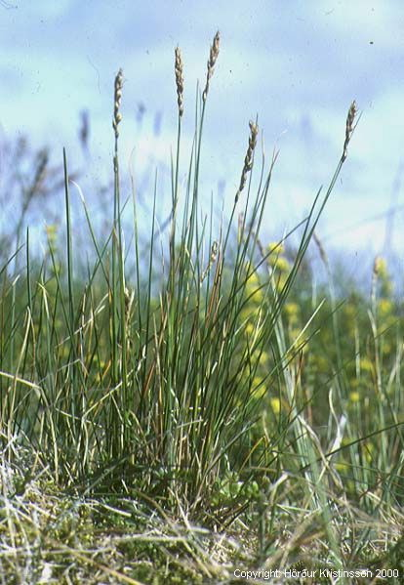
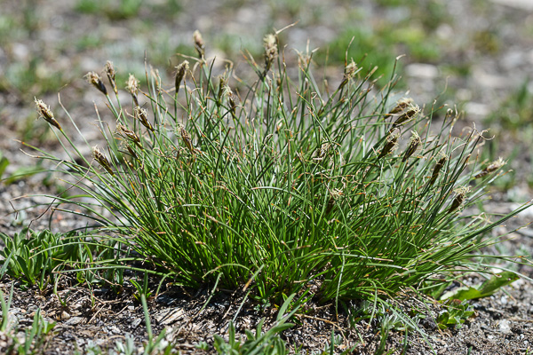
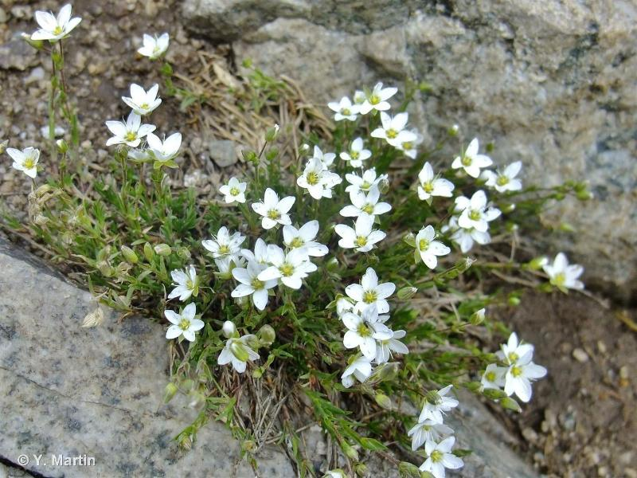
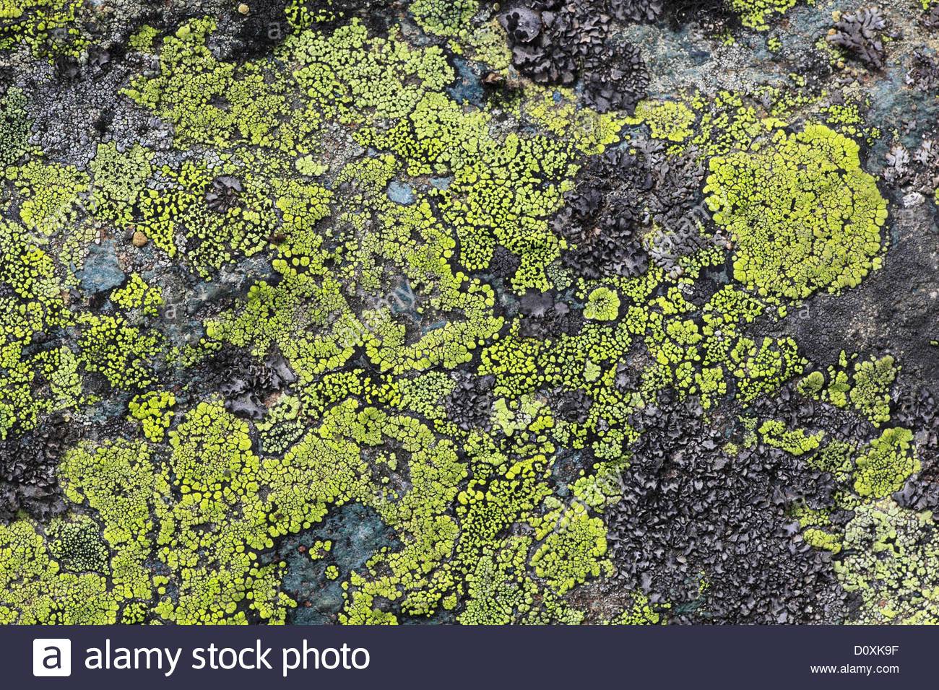
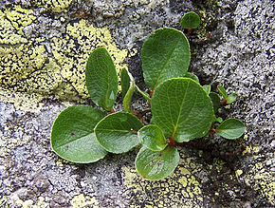
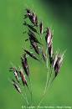
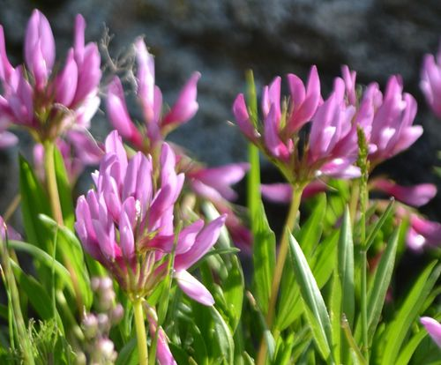
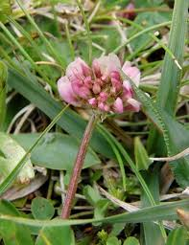
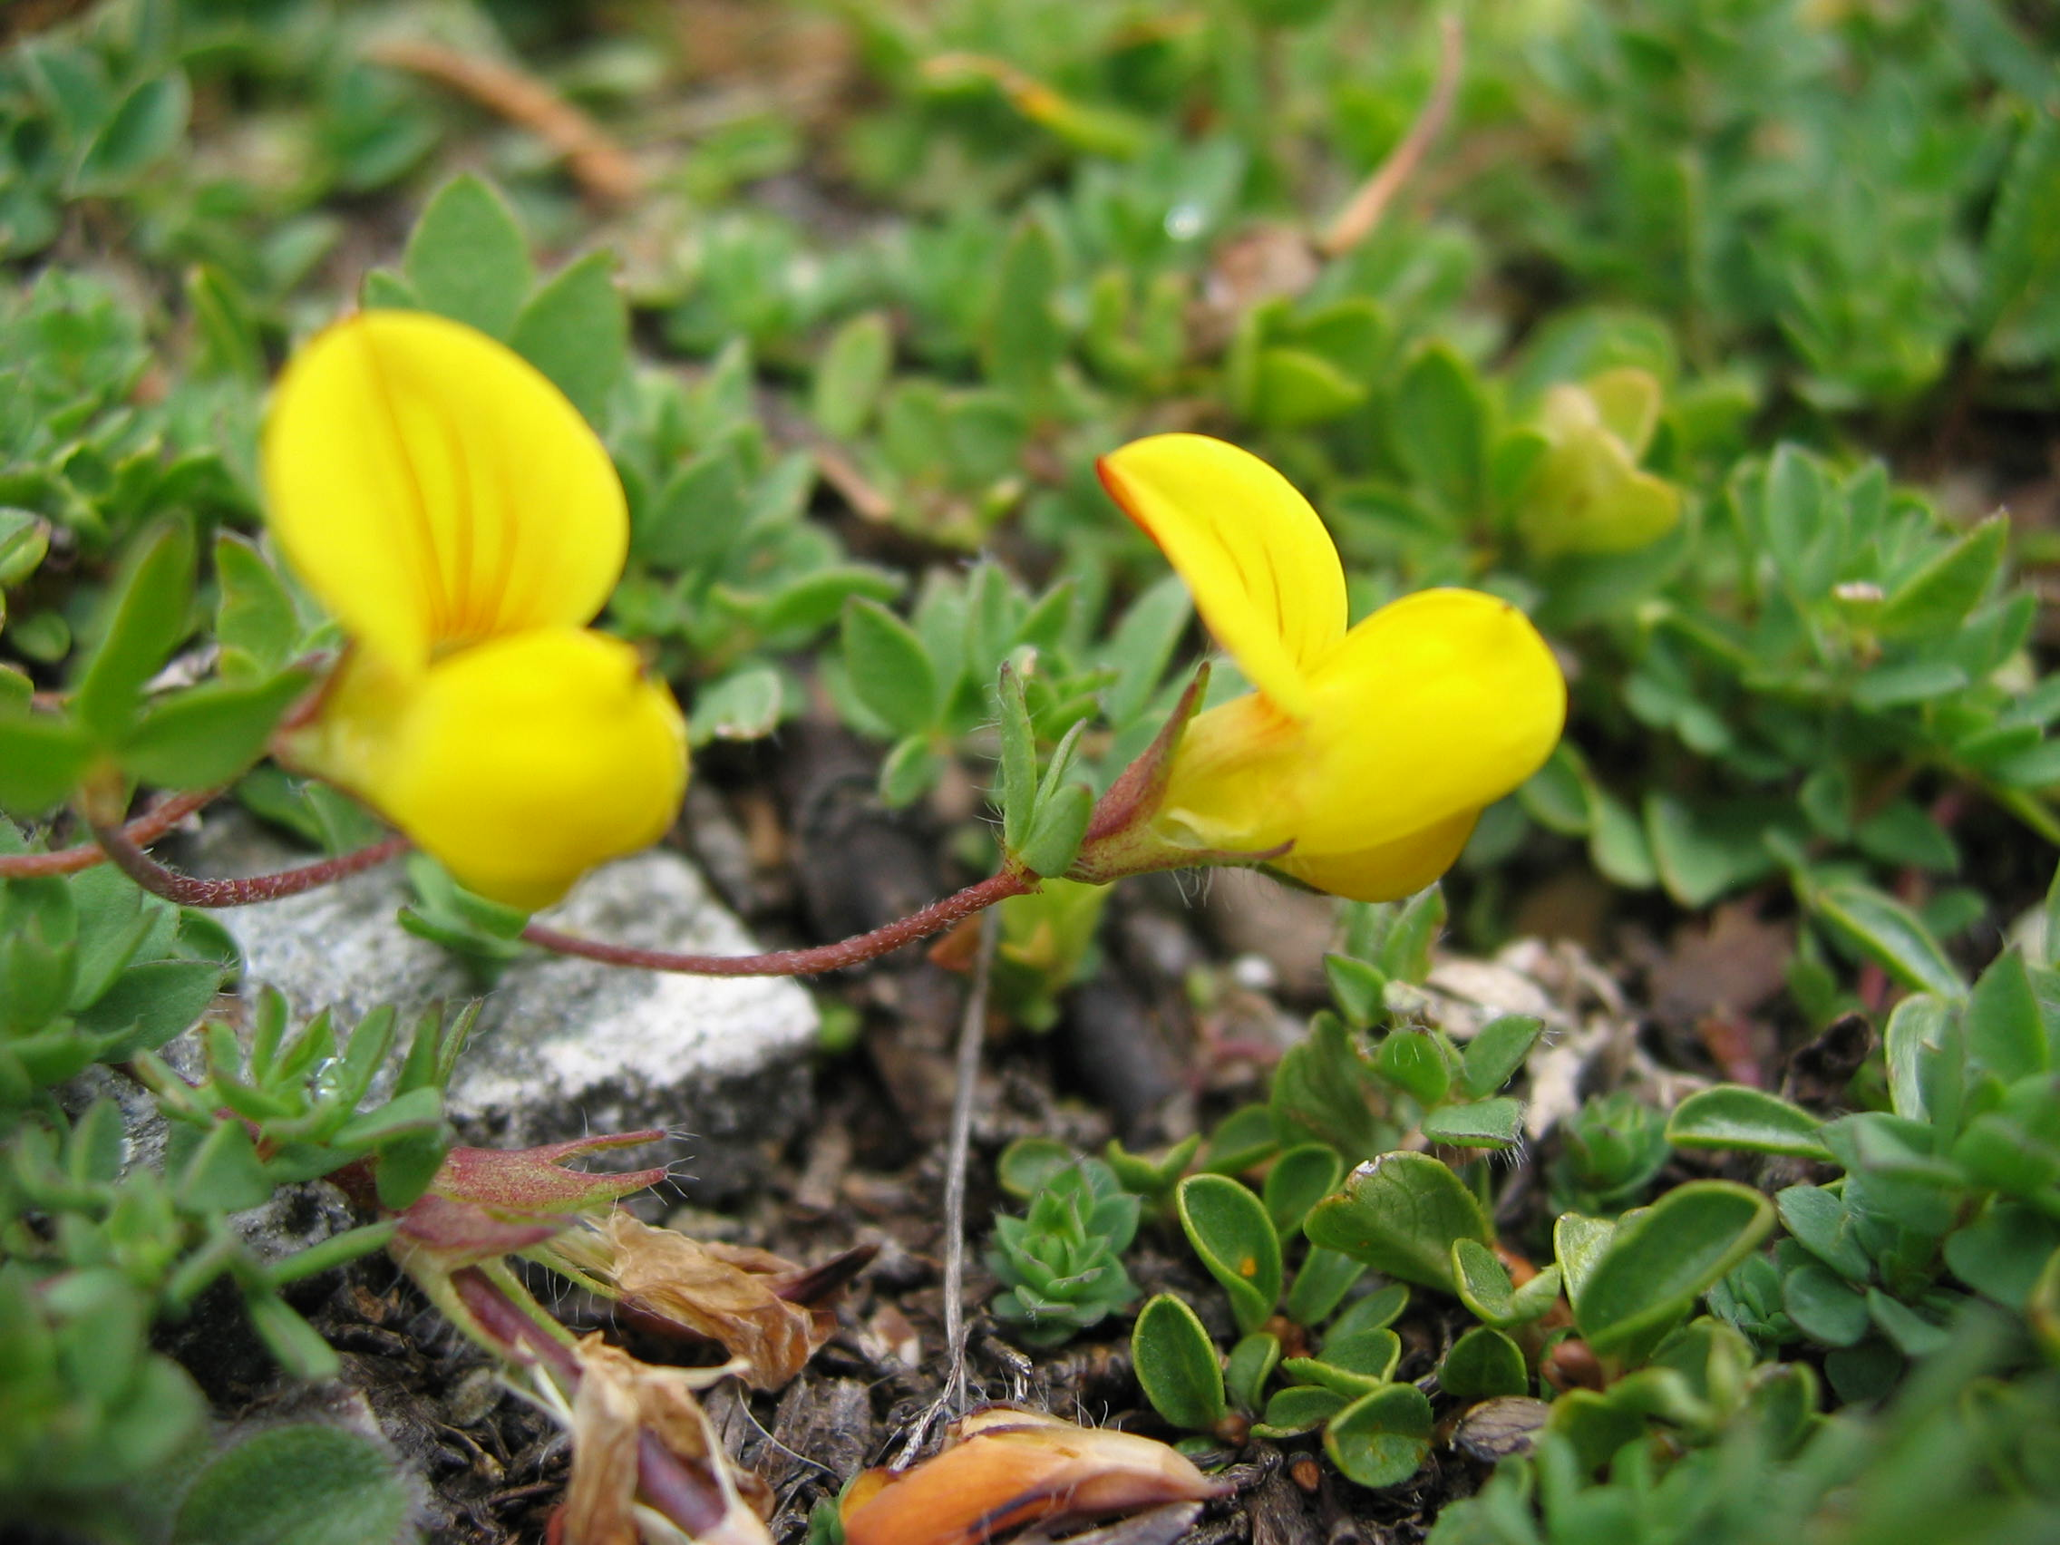
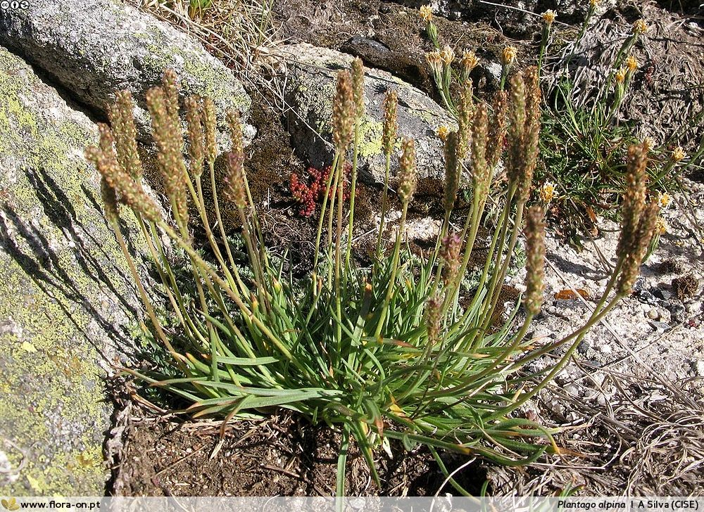
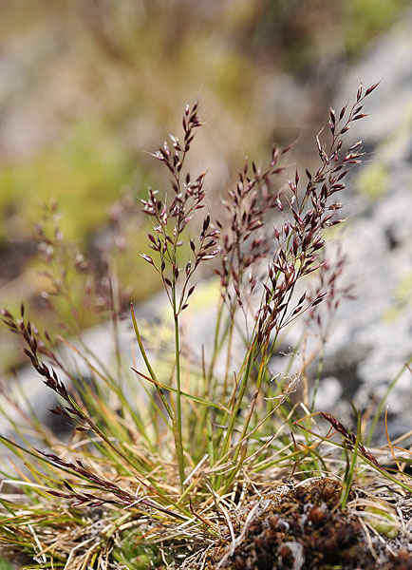
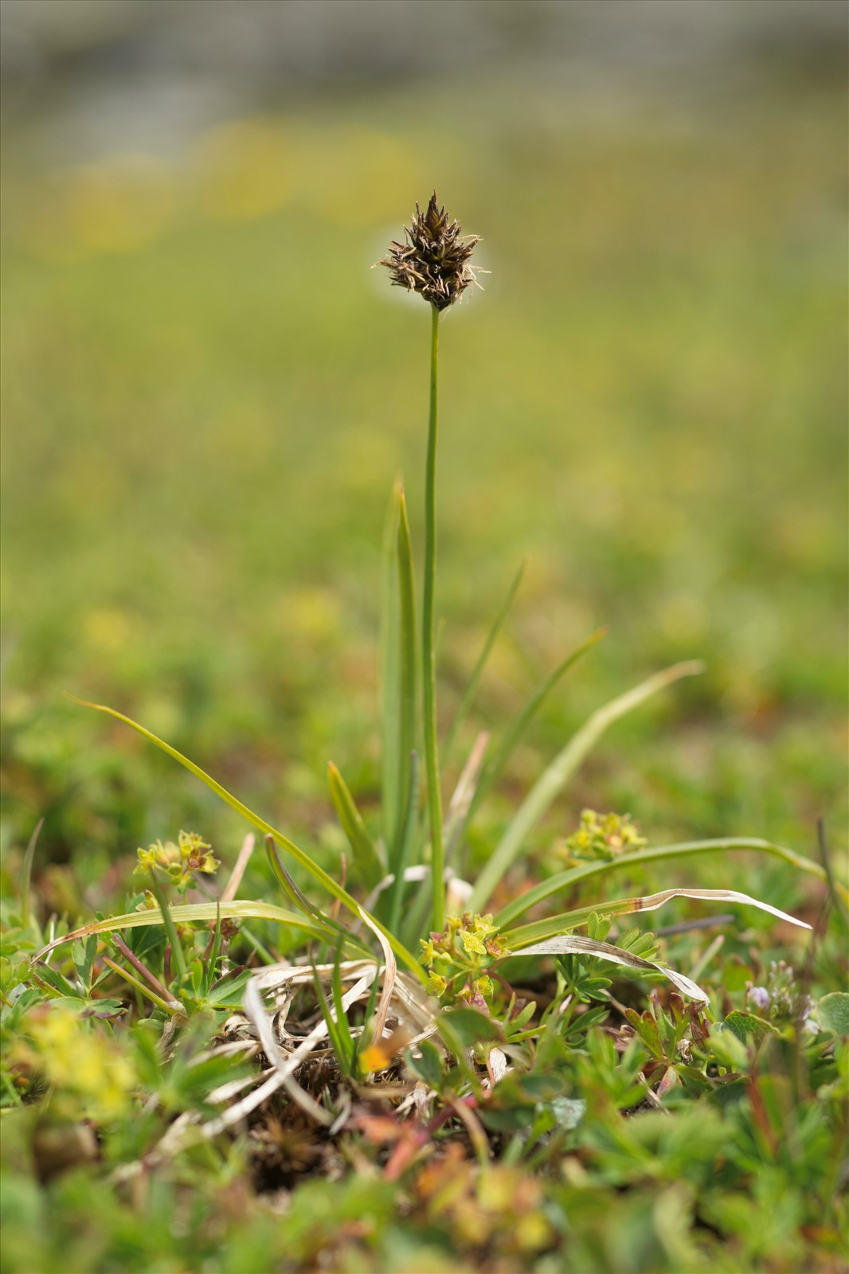
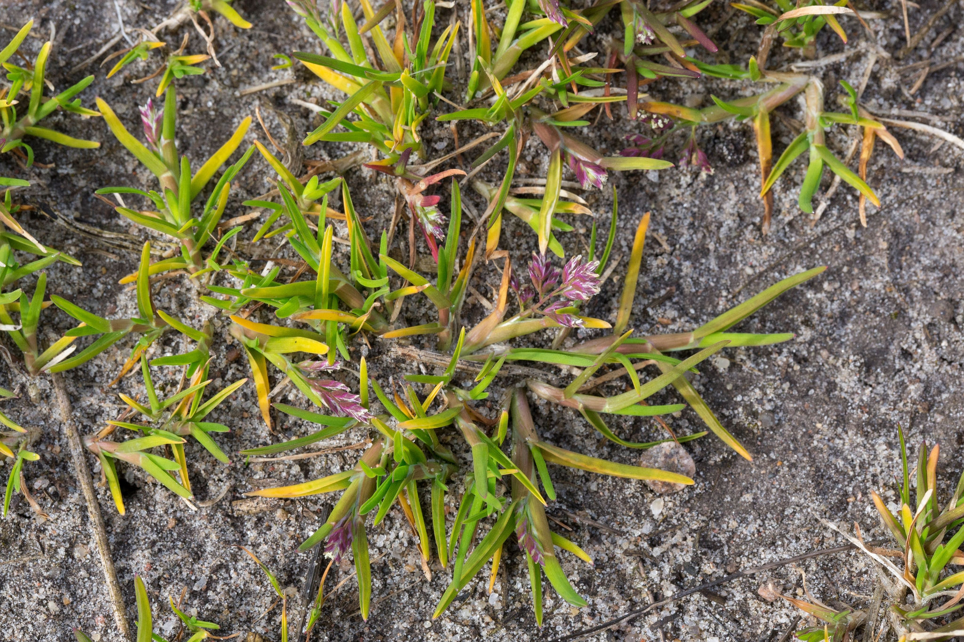
Dominant graminoids
Forbs
Dwarf shrubs
Salix herbacea
Kobresia myosuroides
Carex spp
Minuartia verna
Lichens
Tall grasslands
Festuca violacea
Trifolium alpinum
Trifolium Thalii
Lotus alpinus
Short-herb meadows
Chinopholous vegetation
Plantago alpina
Agrostis rupestris
Carex foetida
Poa supina

Slide 9
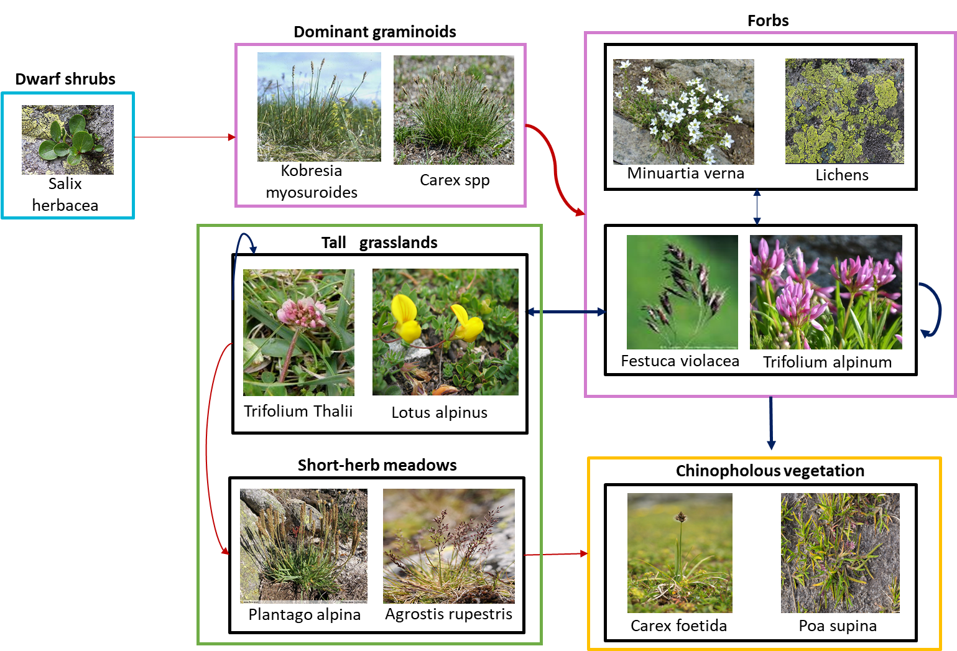

Slide 10
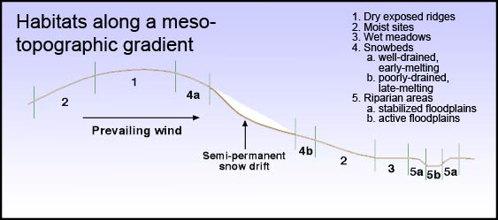
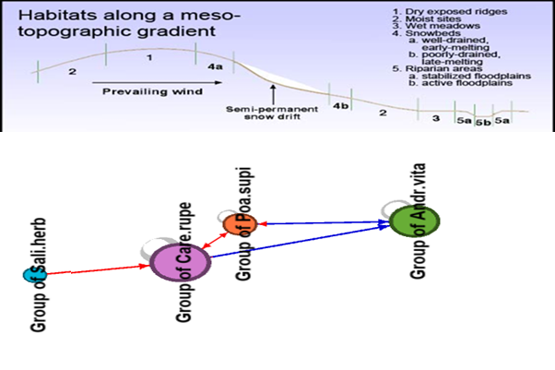
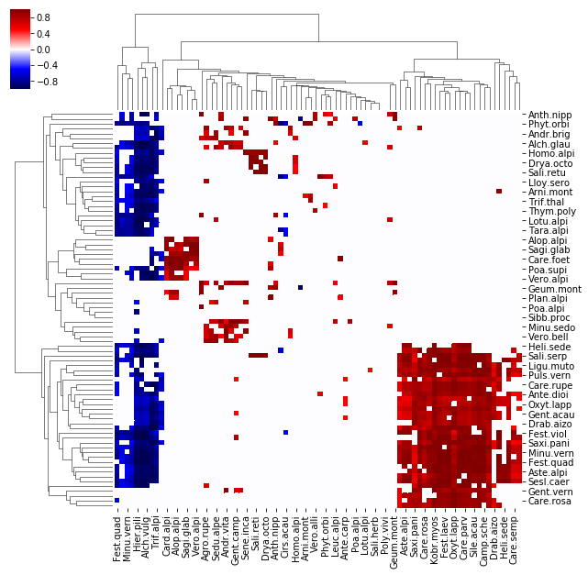
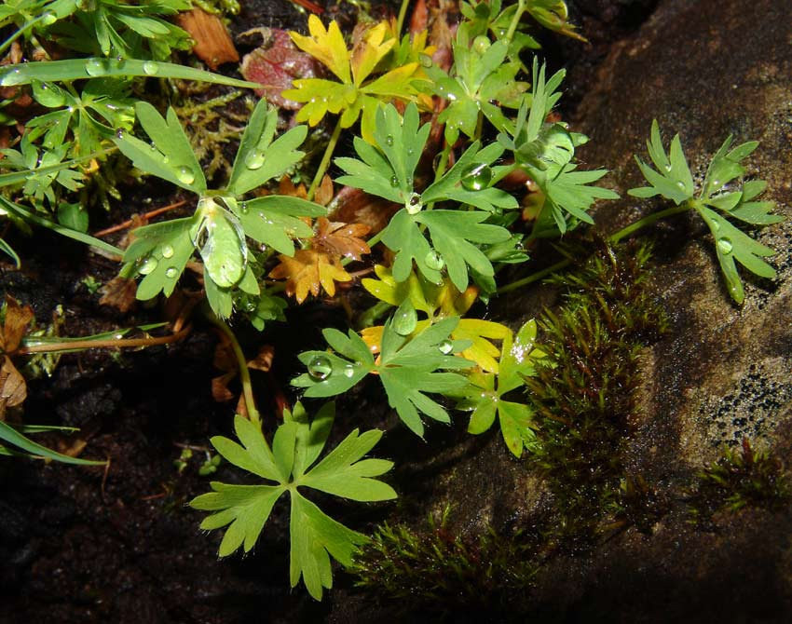
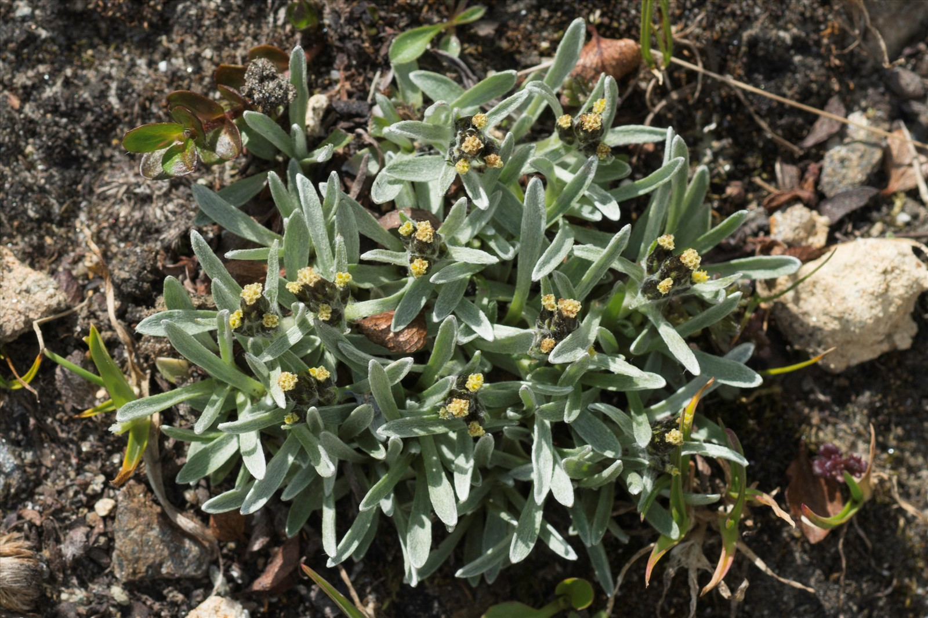
Dwarf shrubs
Short-herb meadows
Salix herbacea
Chinopholous vegetation
Plantago alpina
Agrostis rupestris
Dominant graminoids
Carex foetida
Alchemilla pentaphyllea
Kobresia myosuroides
Carex spp
Gnaphalium supinum
Poa supina
Forbs
Tall grasslands
Minuartia verna
Lichens
Trifolium alpinum
Festuca violacea
Notes:
graminoid tussocks/tuffs/clamps
facilitation est pas mutuelle
Herbaceous = forbs ?
Mécanismes: protection from the wind
Graminoids act to increase biodiversity in such stressful environments
Not species-specific but mostly from type to other
2 south short grassland meadows because of marmot perturbations
whereas 4a are tall grasslands
chionophile = apprécie les conditions hivernales

